Slide 1


HIT140 FOUNDATIONS OF DATA SCIENCE Assessment 2 - Presentation
Lecturer: Yakub Sebastian
Facilitator: Van Hieu Tran
Group members: 1. Nguyen Duy Nguyen Ho (S372109)
2. Thi Thuy Trang Tran (S375041)
3. Minh Hanh Le (S373213)
4. Son Lam Nguyen (S377342)
Notes:
This presentation, titled "HIT140 FOUNDATIONS OF DATA SCIENCE - Assessment 2," was prepared by Group 8, facilitated by Van Hieu Tran, with members Nguyen Duy Nguyen Ho, Thi Thuy Trang Tran, Minh Hanh Le, and Son Lam Nguyen.

Slide 2

Brief Overview
This presentation uses data science techniques to explore how the use of digital screen time affects our sense of well-being. We will conduct two descriptive and two inferential statistical analyses using three datasets provided in the project.
Investigation includes:
The average daily screen time spent on different devices (computers, video games, smartphones, and TV) during weekdays and weekends for males and females.
The Percentage of Low and High Well-being Across Different Digital User Groups
Calculate a 99% confidence interval to estimate the average time screen time across activities (computers, smartphones, gaming, TV)
Hypothesis testing on Well-being scores
Notes:
In this project, we explore how digital screen time impacts well-being using descriptive and inferential statistical methods. Our investigations include analyzing average screen time across devices, examining well-being across different digital user groups, and conducting a confidence interval analysis on screen time activities.

Slide 3
Descriptive Statistics Analyses
Investigation 1: “The Percentage of Low and High Well-being Across Different Digital User Groups”
Notes:
We begin with descriptive statistics, starting with our first investigation on the Percentage of Low and High Well-being Across Different Digital User Groups.

Slide 4
Descriptive Statistics Analyses
OBJECTIVES
This investigation aims to explore the relationship between the amount and type of screen time (computers, gaming, smartphones, and TV watching) and its impact on individuals' well-being. Specifically, we categorize participants into well-being levels (low, medium, high) and analyze how well-being varies across different user groups.
Notes:
Our main goal is to explore how different types of screen time (computers, gaming, smartphones, and TV watching) influence well-being. We categorize participants into low, medium, and high well-being and compare these across different user groups.

Slide 5
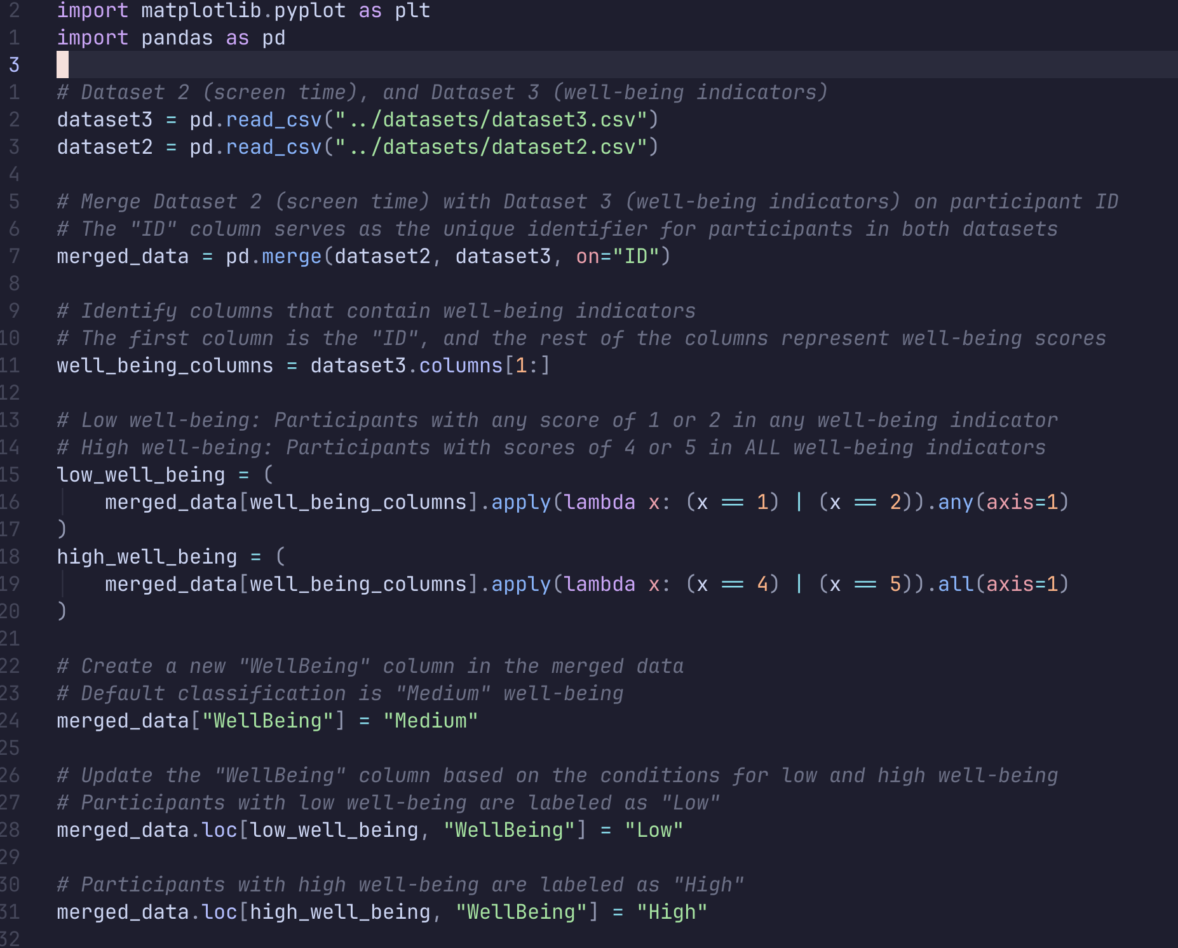
Descriptive Statistics Analyses
ANALYSIS
Identify group of well-being:
Low
Medium
High
Notes:
Analysis: We categorized participants based on their well-being scores:Low Well-being: Scores of 1 or 2 on any indicator.
High Well-being: Scores of 4 or 5 on all indicators.
Medium Well-being: Participants who don’t fit into low or high are categorized as medium.

Slide 6
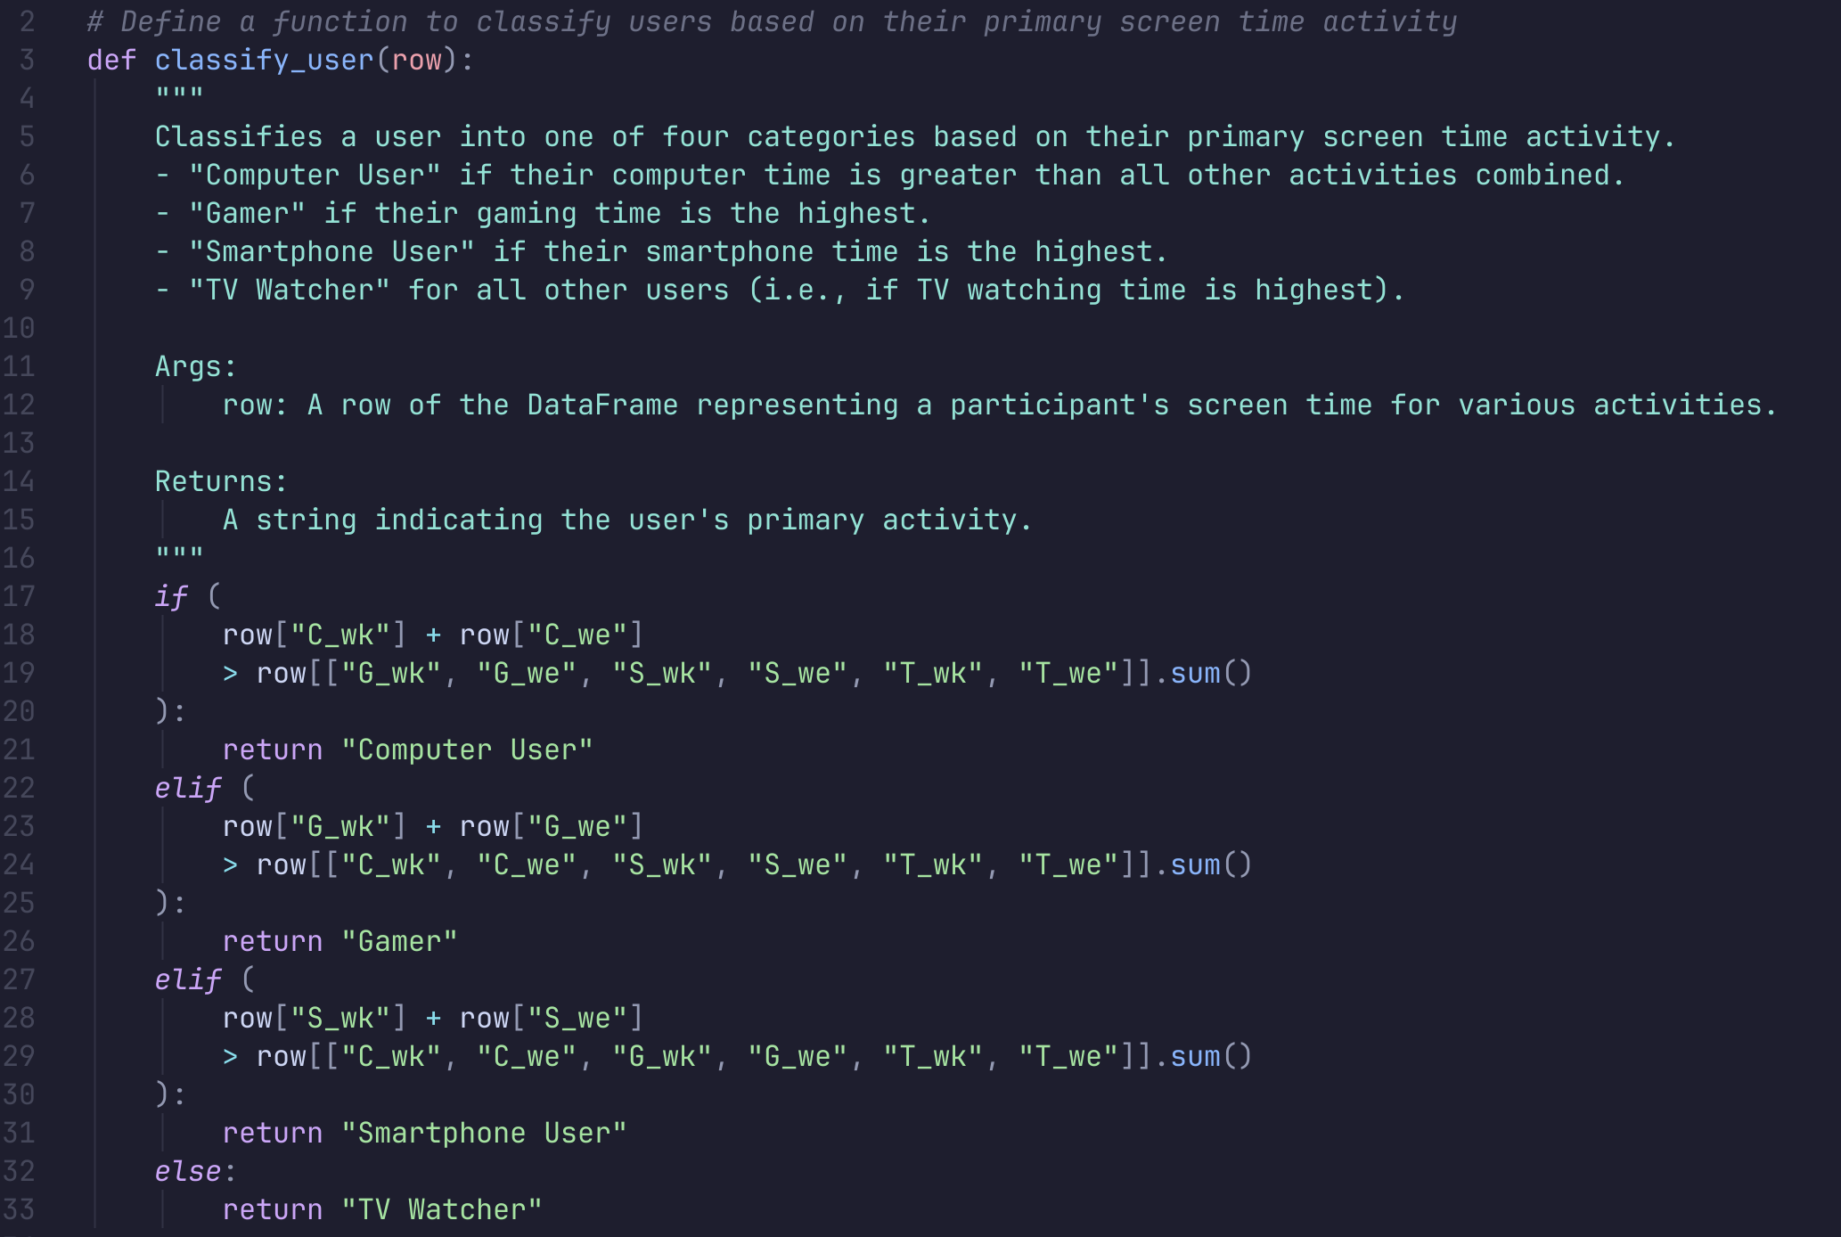
Descriptive Statistics Analyses
ANALYSIS
Classify user:
Computer user
Gamer
Smartphone user
TV watcher
Notes:
Analysis: Participants are classified into four main groups based on their primary screen time activity:
Computer Users
Gamers
Smartphone Users
TV Watchers
This classification helps us understand how different screen time activities relate to well-being.

Slide 7
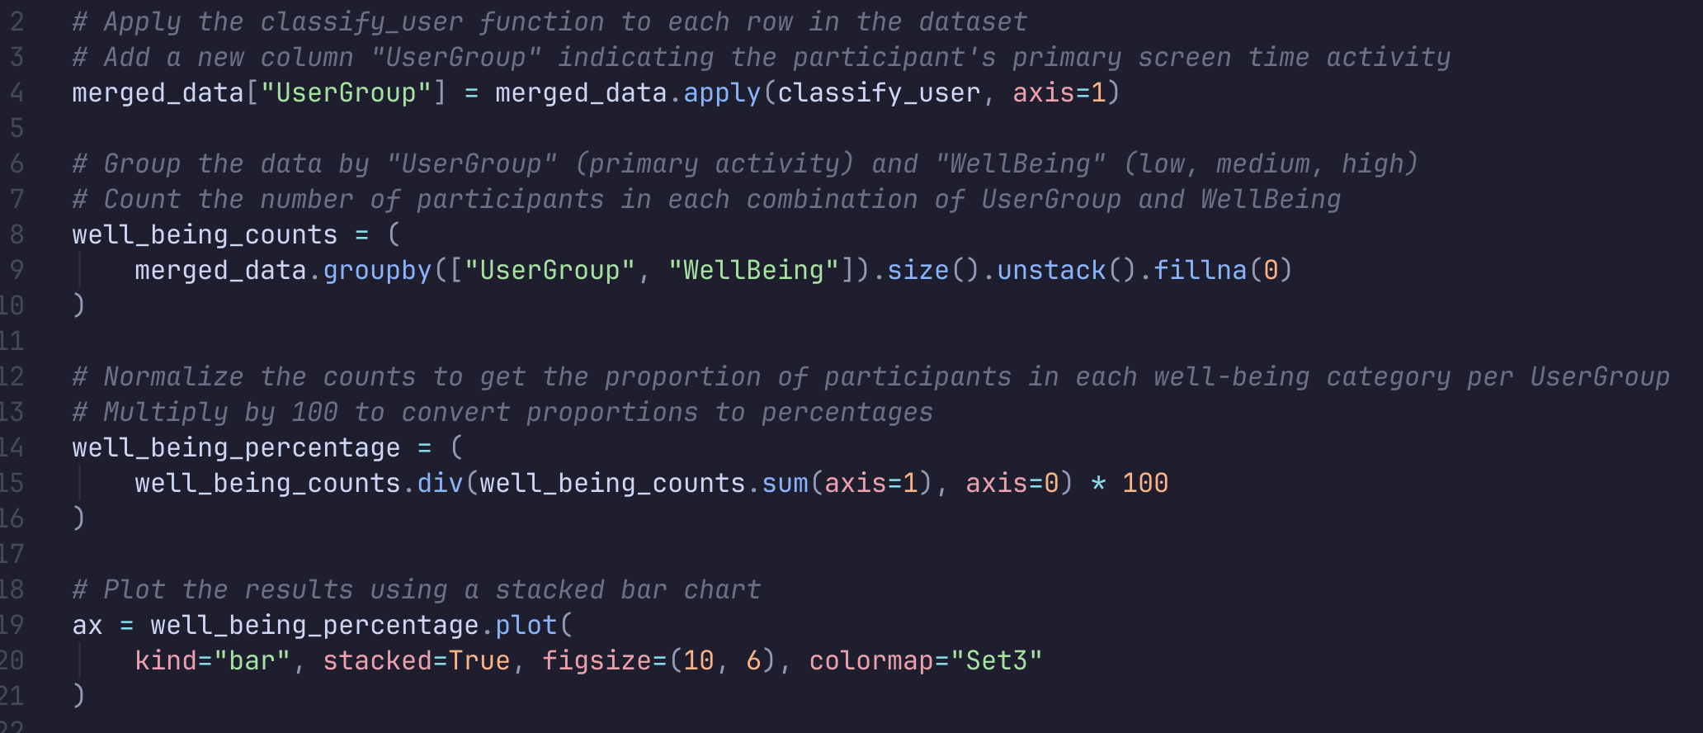
Descriptive Statistics Analyses
ANALYSIS
Merge database
Notes:
To carry out the analysis, we merged datasets on screen time and well-being indicators based on participant IDs, creating a unified data structure for further statistical analyses.

Slide 8
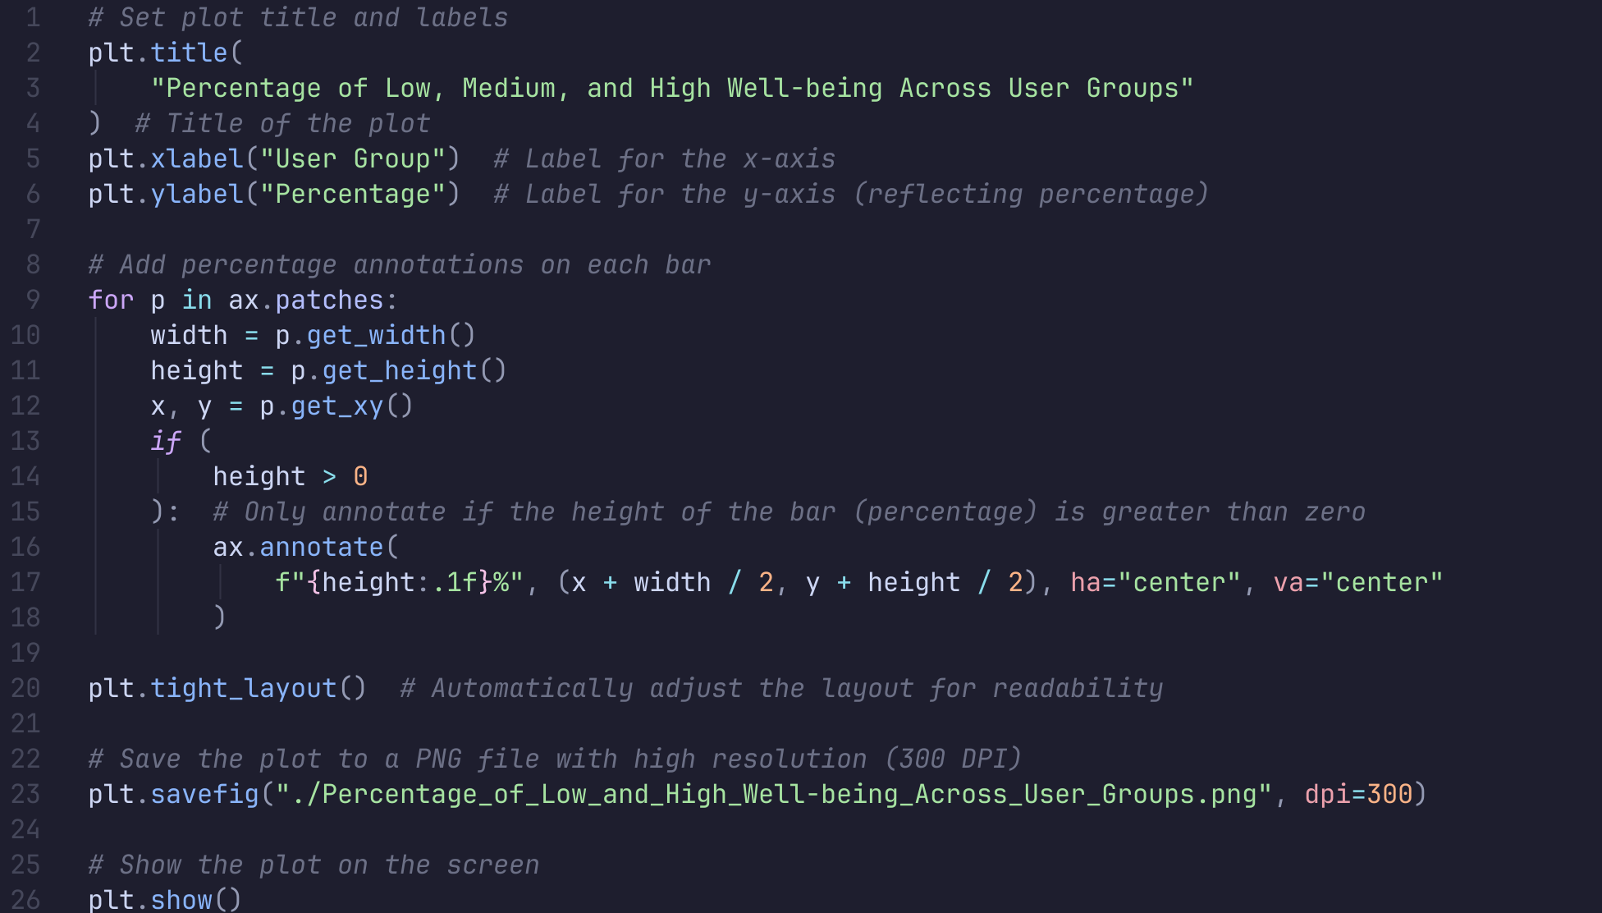
Descriptive Statistics Analyses
ANALYSIS
Draw the plot
Notes:
After preparing the data, we generated visual plots to show how well-being is distributed across user groups. This visualization highlights the proportion of participants in each well-being category (low, medium, high) for different types of screen time.

Slide 9
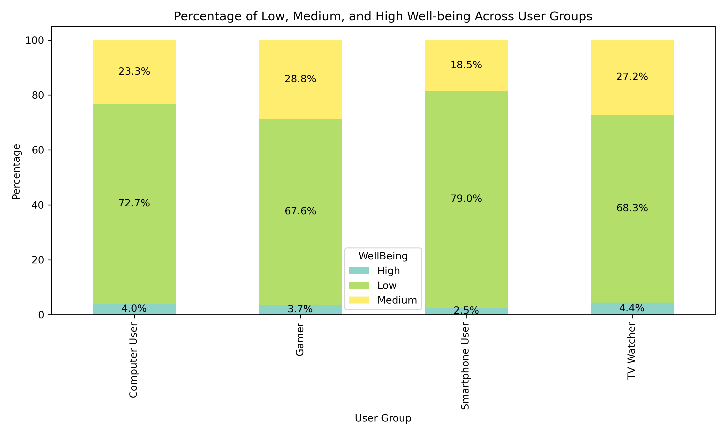
Descriptive Statistics Analyses
Key Insights:
Low Well-being Dominates
Limited High Well-being
Notes:
Observation 1: Low well-being dominates across most user groups. For instance, 72.7% of computer users and 79.0% of smartphone users report low well-being, suggesting that extensive screen time use might negatively impact mental health.
Observation 2: Limited high well-being is observed across groups. For example, only 2.5% of smartphone users report high well-being, the lowest among all groups.

Slide 10
Descriptive Statistics Analyses
CONCLUSION
Takeaways and Recommendations:
The data suggests that not only the duration but also the nature of screen time plays a role in well-being. Passive screen time (like TV watching) might be less harmful than interactive activities that require constant engagement or stress-inducing environments (such as smartphone use or computer work).
Practical Advice: Users should aim to moderate their screen time, especially on smartphones and computers, and engage in more meaningful or balanced digital activities to help maintain or improve their well-being.
Future Research: Further studies should focus on exploring the content quality of screen time, as well as the duration and context in which digital devices are used, to better understand how they impact mental and emotional health.
Notes:
The impact of screen time on well-being depends not just on the duration but also on the nature of the activity. Passive screen time (e.g., TV watching) might be less harmful compared to interactive and potentially stressful activities (e.g., smartphone use or computer work).
Recommendations:Users should aim to moderate their screen time, particularly on smartphones and computers, and prioritize meaningful activities to improve their overall well-being.
Future research should investigate content quality and context to better understand how specific digital interactions affect mental and emotional health.

Slide 11
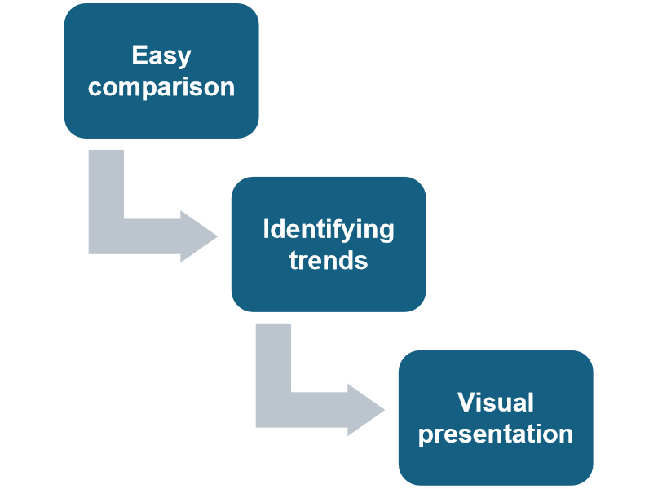
Descriptive Statistics Analyses
Investigation 2: How do male and females differ in their use of digital screen time? Descriptive statistical analysis compares the average time men and women spend on different activities, such as using computers, smartphones, TV, and video games.
Why do we use this method?
Notes:
To answer this question, we use Descriptive statistical analysis to compare the average time men and women spend on different activities, such as using computers, smartphones, TV, and video games.
Easy comparison: Descriptive analysis makes it simple to compare the average screen time of males and females using clear numerical values.
Identifying trends: It helps uncover trends in how males and females allocate their screen time across different activities.
Visual presentation: Bar charts and graphs visually represent the differences, making the data more accessible and easier to grasp.
Moreover, this method provides a broad, yet detailed overview of screen time differences without requiring deep, complex analysis.

Slide 12
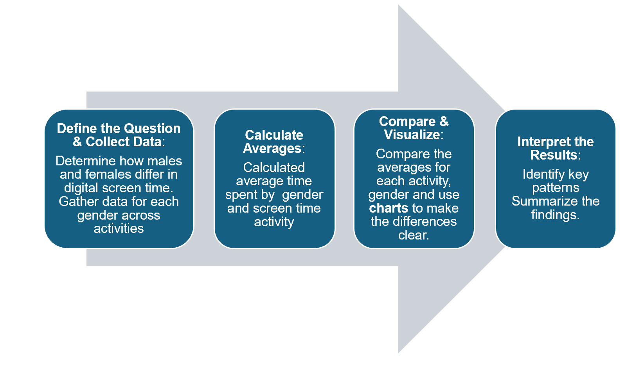
Descriptive Statistics Analyses
4 Steps for Descriptive Statistical Analysis
Notes:
4 Steps for Descriptive Statistical Analysis
Define the Question & Collect Data:
Determine how males and females differ in digital screen time. Gather data for each gender across activities.
Calculate Averages:
Calculate the average time spent by gender and screen time activity.
Compare & Visualize:
Compare the averages for each activity, gender, and use charts to make the differences clear.
Interpret the Results:
Identify key patterns and summarize the findings.

Slide 13
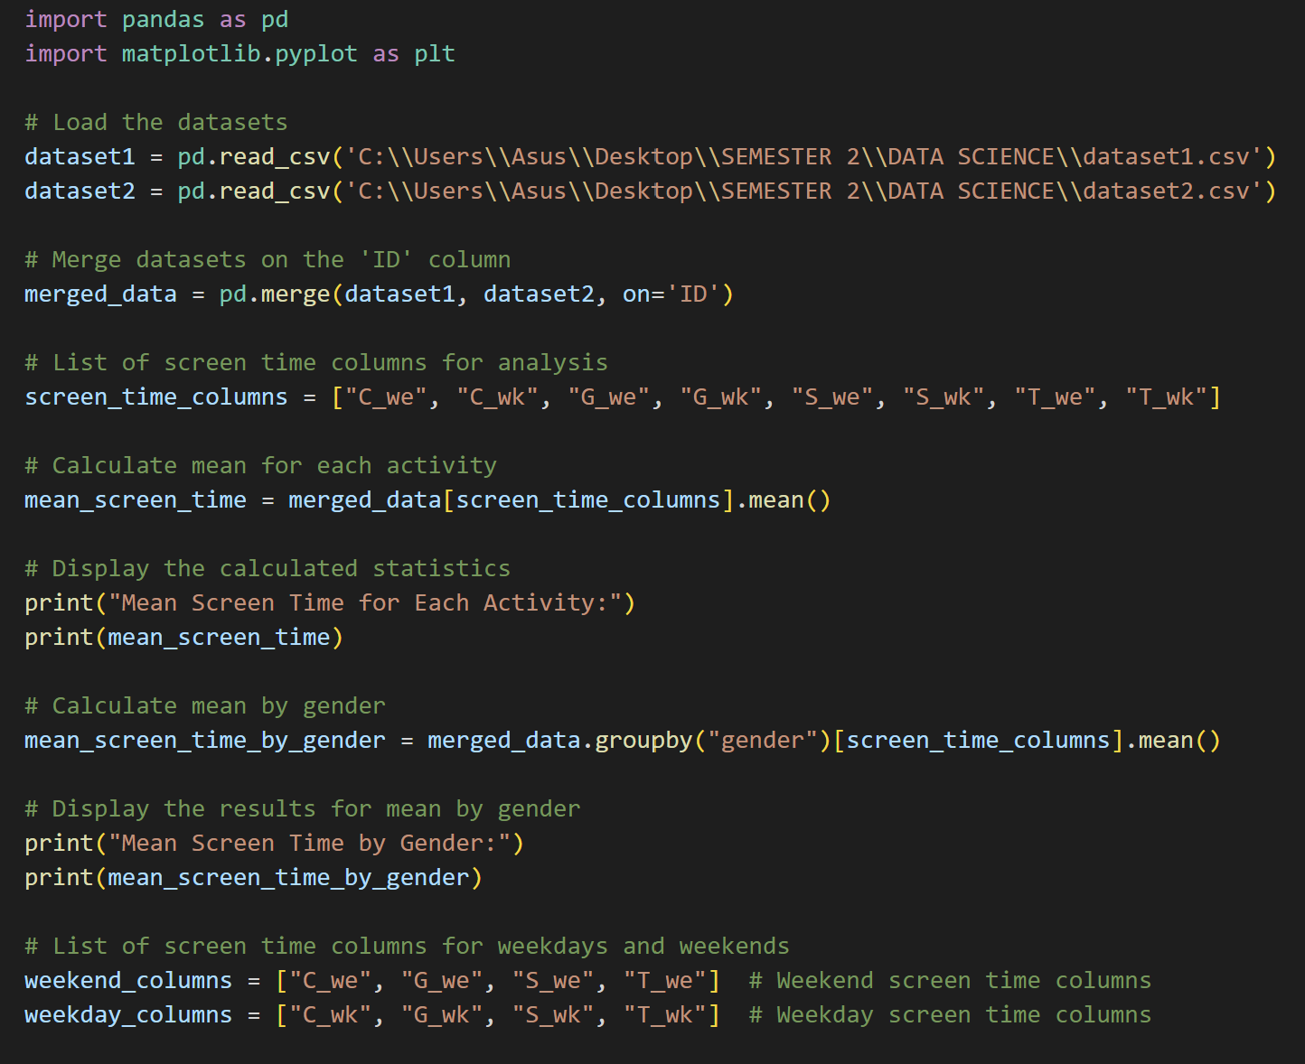
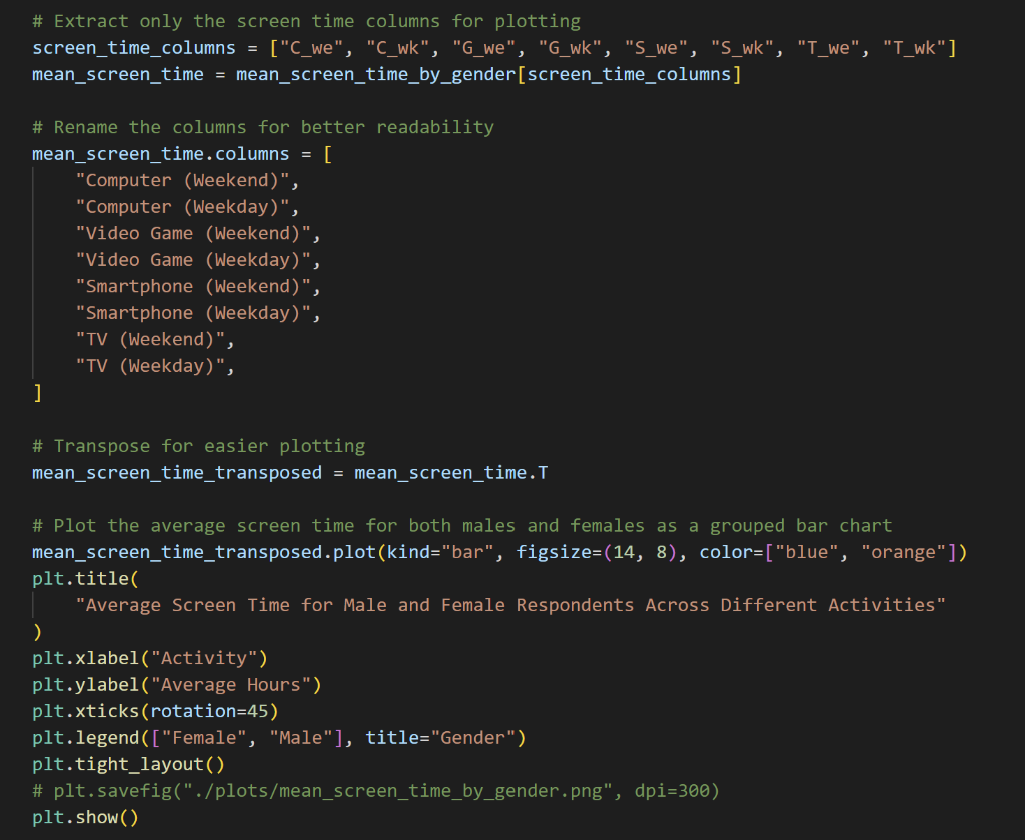
Descriptive Statistics Analyses
Python code implementation compares the average time Males and Females spend on different activities.
Notes:
I would like to show you the coding process. we have 5 steps:
Load and Merge Data
Select Columns for Analysis
Calculate Averages
Group by Gender
Visualize with Bar Chart

Slide 14
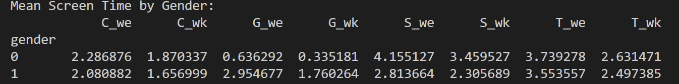
Descriptive Statistics Analyses
Outcome of descriptive analysis compares the average time males and females spend on different activities.
Overall, Females usually spend more time on computers, smartphones, and TV during both weekends and weekdays. They spend the most time on smartphones, with 4.16 hours on weekends and 3.46 hours on weekdays.
On the other hand, Males spend most of their time on video games, particularly during weekends with 2.95 hours, and with 1.76 hours On weekdays

Slide 15
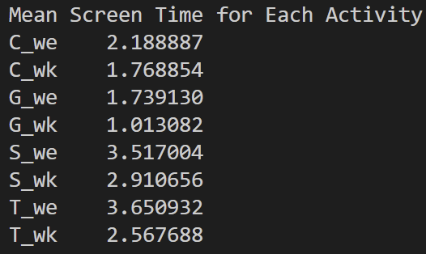
Descriptive Statistics Analyses
Outcome of descriptive analysis compares the average time males and females spend on different activities.
The highest average screen time is for watching TV on weekends, with 3.65 hours.
The second highest activity is using smartphones on weekends, with an average of 3.52 hours.
The lowest average screen time is for playing video games on weekdays, with only 1.01 hours.
Notes:
the second outcome we will caculate the Mean Screen Time for Each Activity
Looking at the bar chart we can see TV and smartphone have avagergae screentime is high on the weekend, and the highest is watching TV on the weekend.
on the other hand , The lowest average screen time is for playing video games on weekdays

Slide 16
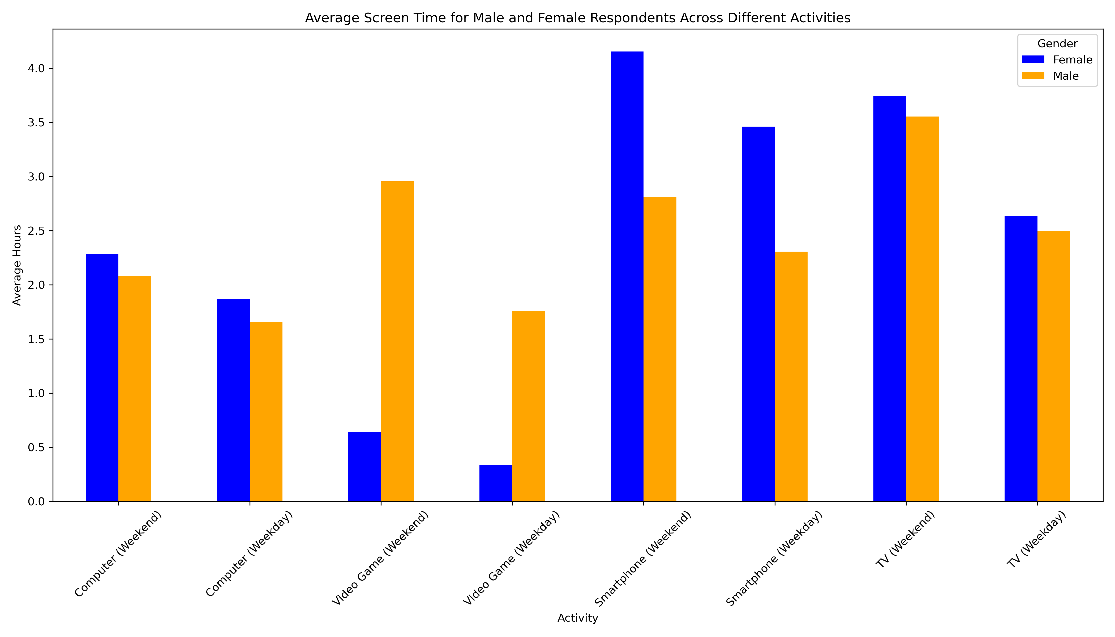
Descriptive Statistics Analyses
The highest bar in the chart is females' smartphone use on weekends, with 4 hours. This shows that females spend the most time on their smartphones during weekends.
The lowest bar is females' video game use on weekdays, at less than 0.5 hours. It mean females spend very little time playing video games during weekdays.
Both males and females spend more time on digital devices during weekends compared to weekdays.
Notes:
To make it easier to visualize descriptive statistics analysis, we use bar charts.
The bar chart show the avergage screen time beweent males and female in different activities
The highest bar in the chart is females' smartphone use on weekends, with 4 hours. This shows that females spend the most time on their smartphones during weekends.​
The lowest bar is females' video game use on weekdays, at less than 0.5 hours.
​Females focus more on smartphones and TV, while males prefer video games, especially during weekends.
Both males and females spend more time on digital devices during weekends compared to weekdays.​

Slide 17
Inferential Statistics Analyses
What are the average screen time across activities (computers, gaming, smartphones, TV) at 99% confidence level?
For each activity, statistic information is required included:
- Sample mean ($\overline{X}$)
- Standard Deviation (SD)
- Sample size (n)
- Standard error (SE)
For each activity, statistic information is required included:
- Sample mean (X ̅)
- Standard Deviation (SD)
- Sample size (n)
- Standard error (SE)
Use the t-critical value and standard error to calculate the confidence interval for each activity (computers, gaming, smartphones, TV)
Based on the CI results to:
- Recognize the average time across activities (computers, gaming, smartphones, TV) at 99% confidence level.
- Compare screen time on weekends and weekdays across activities (computers, gaming, smartphones, TV).
Step 1: Define problem
Step 2: Collect the data
Step 3: Compute Confidence Intervals (CI)
Step 4: Conclusion

Slide 18
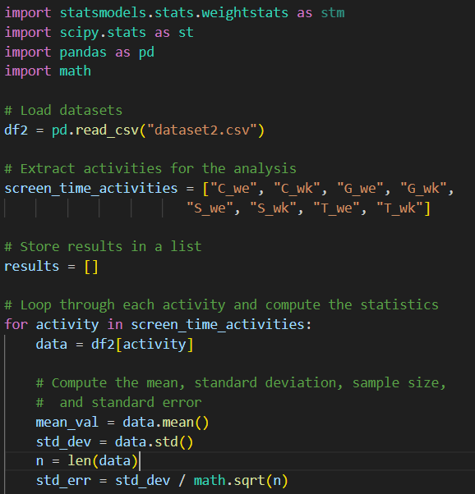
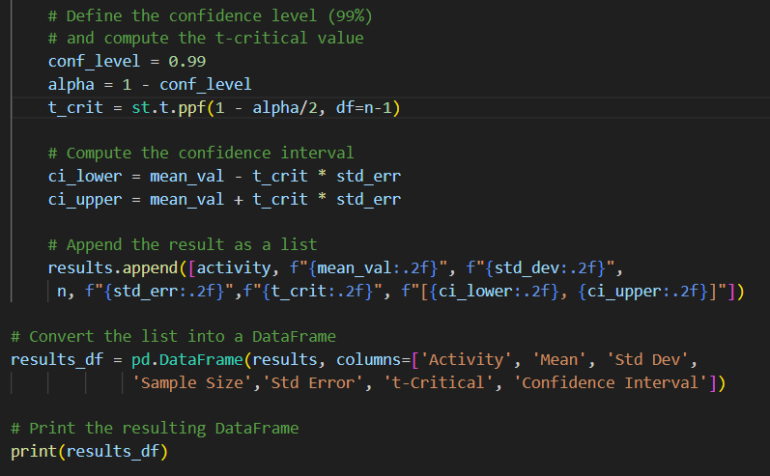
Inferential Statistics Analyses
Python code implementation for the Confidence Interval across screen time activities.

Slide 19
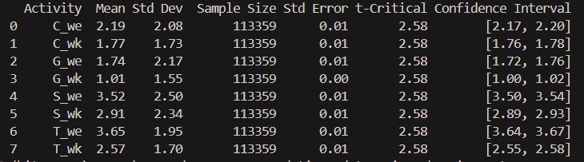
Inferential Statistics Analyses
The result by Python coding:
Based on 99% Confidence Interval across activities, the statistics shows that:
- The average screen time for each activity.
Screen time increases on weekends compared to weekdays.
The narrow confidence intervals show high precision due to the large sample size (113,359) , so that making these estimates reliable.
This analysis provides clear evidence that people engage in more screen-related activities during their free time on weekends.

Slide 20
Inferential Statistics Analyses
For examples of computer activity on weekdays and weekends:
- C_we (Weekends): The average time spent using computers on weekends is 2.19 hours, with a 99% confidence interval of [ 2.17, 2.20 ].
- C_wk (Weekdays): The average time spent using computers on weekdays is 1.77 hours, with a 99% confidence interval of [ 1.76, 1.78 ].
→ Overall, people spend more time on their computers during weekends than on weekdays. Since the confidence intervals are very narrow (0.02-0.03), we can trust these estimates as being very accurate based on 99% confidence interval level.

Slide 21
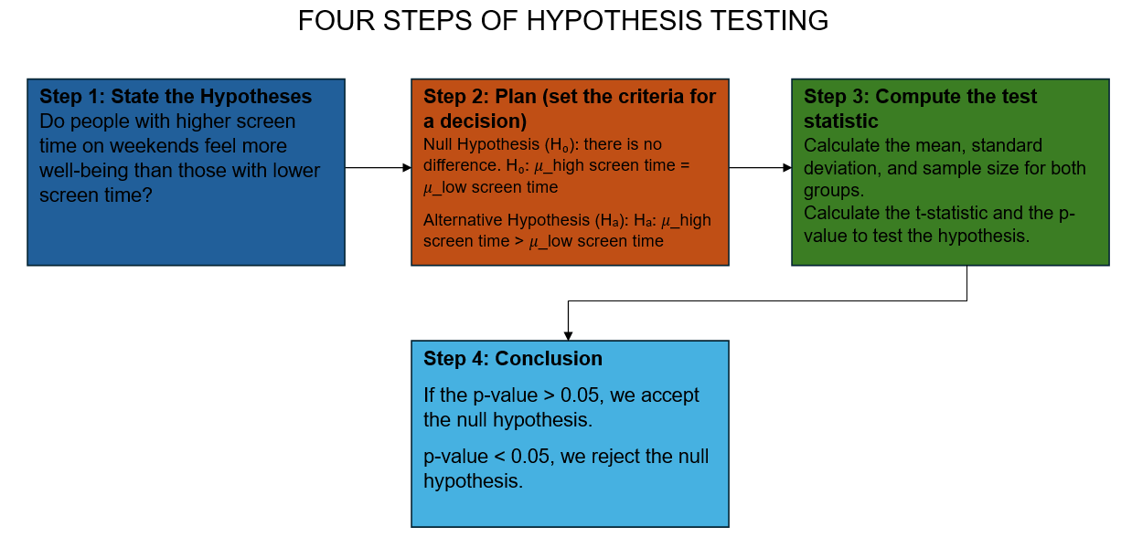
Inferential Statistics Analyses
Investigation:
Hypothesis testing on Well-being scores
Whether there is a significant difference in well-being between people with high screen time and those with low screen time on weekends.
We assume that higher screen time correlates with increased well-being. We'll test this hypothesis using statistical methods.
Notes:
This investigation aims to explore whether there is a significant difference in the well-being between people with high screen time and those with low screen time on weekends. Specifically, the investigation will follow the 4-step hypothesis testing process to determine if those with higher average screen time experience greater well-being.
Step 1: State the Hypotheses
The practical question is: Do people with higher screen time on weekends feel more well-being than those with lower screen time?
We assume that higher screen time correlates with increased well-being. We'll test this hypothesis using statistical methods.
Step 2: Plan (set the criteria for a decision)
Parameters:
Population: Children and adolescents who participated in the survey.
Parameter of interest: Mean well-being score.
Grouping variable: Weekend screen time (categorized into high and low groups).
Hypotheses:
Null Hypothesis (H₀): There is no difference in the well-being scores between people with high and low screen time on weekends.
H₀: 𝜇_high screen time = 𝜇_low screen time
Alternative Hypothesis (Hₐ): People with higher screen time on weekends will experience greater well-being than those with lower screen time. Hₐ:
𝜇_high screen time > 𝜇_low screen time
Step 3: Compute the test statistic
To address this question, we used data from datasets 1,2 and 3. We first categorized respondents into two groups based on their screen time and calculated the mean, standard deviation, and sample size for both groups.
Then, I calculated the t-statistic and the p-value to test our hypothesis.
Step 4: Conclusion
Comparing the p-value to the significance level of 0.05

Slide 22
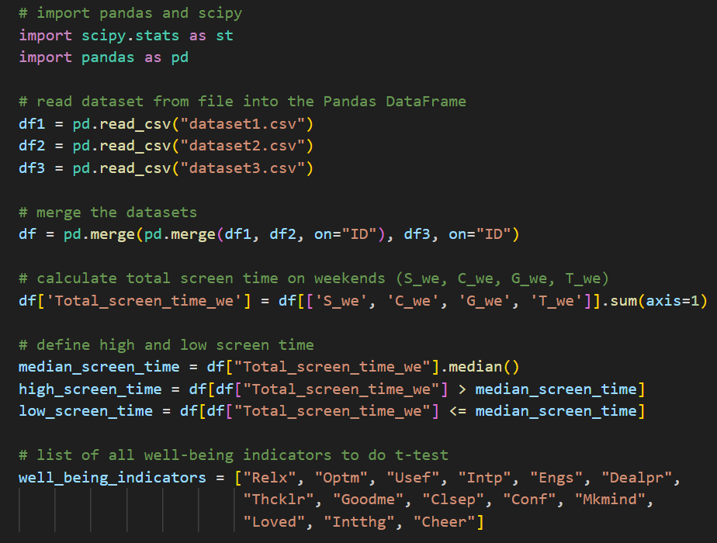
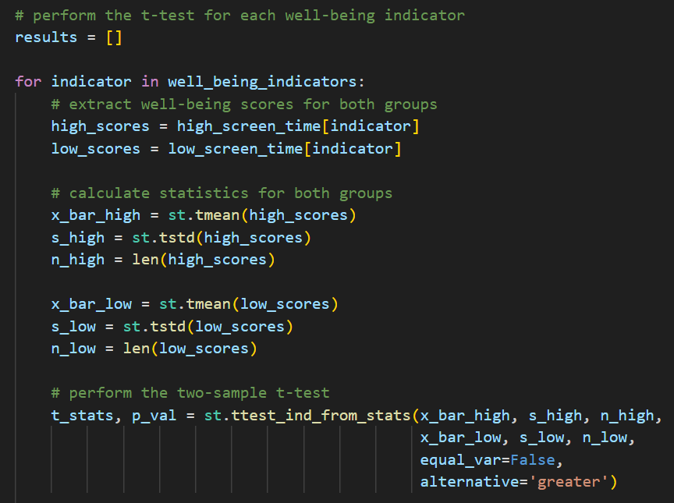
Inferential Statistics Analyses
Python code implementation for the Hypothesis testing across the well-being indicators
Notes:
We will use two Python libraries in this investigation: Scipy and Pandas.
Dataset 1,2,3 and merge them using the column ID
Calculate the total screen time of devices on the weekend
Define the screen time for 2 groups, high screen time and low screen time, by calculating the median
Calcualte the mean, standard deviation, sample for both groups and then perform the two-sample t-test

Slide 23
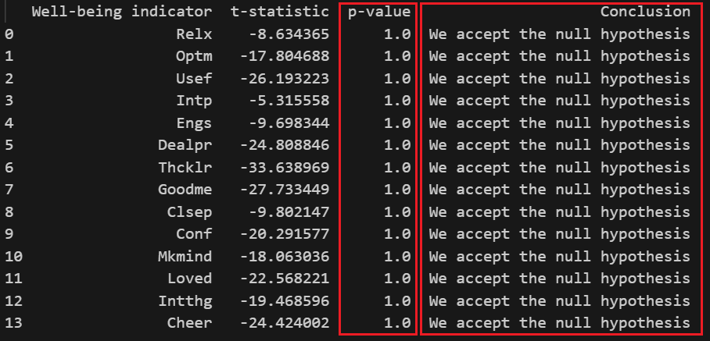
Inferential Statistics Analyses
Analysis results:
Comparing the p-value to the significance level of 0.05, we can see the p-value is 1.0, and it’s > 0.05, so we accept the null hypothesis

Slide 24
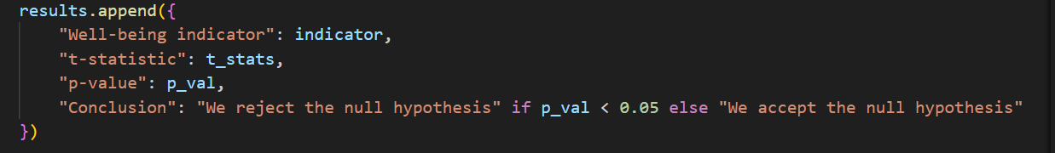

Inferential Statistics Analyses
Analysis conclusion:
Accept the null hypothesis (H0) | There is no significant difference in well-being scores between people with high and low screen time on weekends. Whether high or low, it also has the same influence on the well-being scores.
Source: Ananda.ai – Mental Health

